Slide 1
Temperature Measurement
UNIT 1
Industrial Instrumentation

Slide 2
Heat
The motion of atoms or molecules with energy.
Temperature
Measure of the energy

Slide 3
Conversion
[°F] = [°C] × 9⁄5 + 32
[°C] = ([°F] − 32) × 5⁄9
[K] = [°C] + 273.15
[°C] = [K] − 273.15

Slide 4
Thermo wells
To protect temperature sensors
Uses in piping systems and subject to hydrostatic and others
designed to protect a temperature sensor from flow, high pressure and harsh environments
Thermo wells are (1) threaded, (2) sanitary, and (3) flanged welded, etc

Slide 5
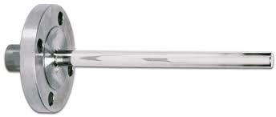
Flanged type

Slide 6
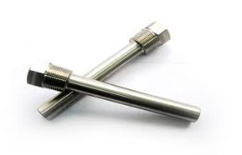
Threaded type

Slide 7
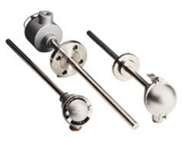
Sanitary type

Slide 8
Selecting a Thermo well
(1) immersion length,
(2) potential for vibration, and
(3) material.

Slide 9
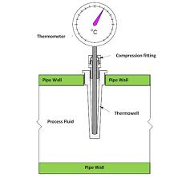
Immersion of TW

Slide 10
Thermowell materials
316 Stainless Steel
Best corrosion resistance 900 ºC
Carbon Steels
Low temp & stress applications, temp 500 ºC
304 Stainless Steel
  Low cost , corrosion resistance 900 ºC
  Others are Inconel, Hastelloy, Titanium, Monel, Teflon etc

Slide 11
Classification of Temperature Transducers
Change in physical dimensions
Liquid in glass 75 to 650 ºC
Bimetallic strip -65 to 430 ºC
Change in pressure
  Gas pressure -270 to 760 ºC
  Liquid pressure -37 to 630 ºC
  Vapour -73 to 343 ºC

Slide 12
Change in thermal radiations
  Optical sensing 1400 to 6300 ºF
  Radiation sensing 0 to 3870 ºC
  Infrared sensing -15 to 3300 ºC
Change in electrical property
  Thermocouple -270 to 2310 ºC
  RTD -270 to 980 ºC
  Semiconductor -272 to 150 ºC

Slide 13
Bimetallic Strips
Two strips of different metals with different temperature expansion coefficients
  Steel and Copper
  Steel and Brass
Bonding may be done by riveting, brazing or welding
change in L = a * L_{o} * (T - T_{o})
  L_{o} be the length of the solid when the temperature is T_{o}

Slide 14
Material | Expansion Coefficient
Aluminium | 2.4 x 10⁻⁵ K⁻¹
Iron (steel) | 1.2 x 10⁻⁵ K⁻¹
Copper | 1.7 x 10⁻⁵ K⁻¹
Brass | 1.9 x 10⁻⁵ K⁻¹
Glass (pyrex) | 3.3 x 10⁻⁶ K⁻¹
Concrete | 1.2 x 10⁻⁵ K⁻¹
Invar | <1.3 x 10⁻⁶ K⁻¹

Slide 15
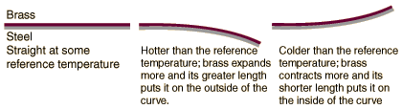
Working

Slide 16
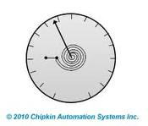
BS types
Bimetallic elements can be arranged in the flat, spiral, single helix and multiple helix configurations

Slide 17
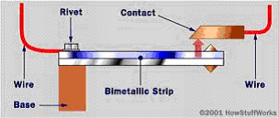
ON-OFF Control

Slide 18
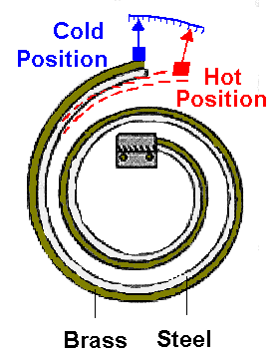
Measuring

Slide 19
Resistance Temperature Detector
A basic physical property of a metal is that its electrical resistivity changes with temperature
Metals such as platinum, copper, tungsten and nickel increases their resistance with growth in temperature, they have positive temperature coefficient of resistance

Slide 20
Desire Properties
Certain properties are desirable in material used for resistance thermometer elements. It should have good resistivity
It should give linear response output
The material should be corrosion resistant

Slide 21
Resistance Equation
R(T)=R0 [1+A(T-T0)+B(T-T0)²]
  R(T)=the resistance at temp T
  R0=The resistance at a reference temp T0
  A & B are Temperature Coefficient constant
  Commercial platinum grades exhibit a temperature coefficient of resistance 0.00385/°C

Slide 22
The resistance element is most often, a metal wire wrapped around an electrically insulating support of glass, ceramic or mica
Nominal resistance is the pre-specified resistance value at a given temperature
The International Electrotechnical Commission (IEC) specifies the standard based on 100.00 Ohms at 0°C, but other nominal resistance's are quite common

Slide 23

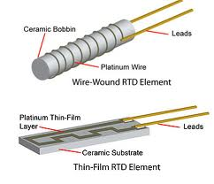

Slide 24
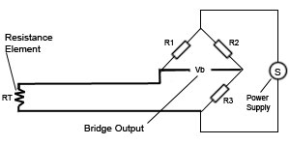
Two Wire

Slide 25
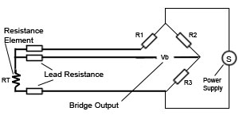
Three wire

Slide 26
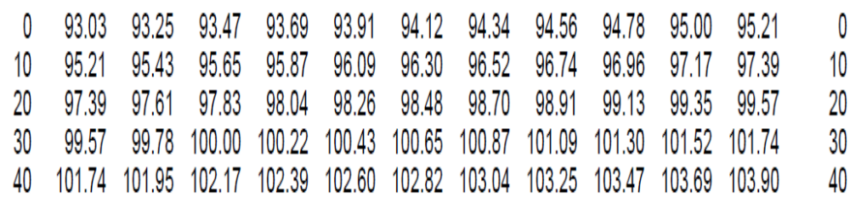
Platinum RTDs can measure temperatures from -200°C to 650°C
In the table, left most column and right most colum are temp in °F and remain are change in reistance for each °F for pt 100 RTD

Slide 27
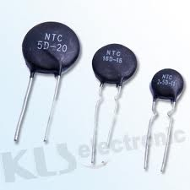
Thermistors
It is like RTD but it has NTC
Range below 150 C
Non linear
Desire shape
Made by Oxides of Metals like copper, manganese, nickel, cobalt, and lithum

Slide 28

Temp Vs Resistance
The thermistor resistance-temperature relationship can be approximated by,
where: T is temperature (in kelvin), TRef is the reference temperature, usually at room temp. (25 °C; 77 °F; 298.15 K), R is the resistance of the thermistor (W), RRef is the resistance at TRef, b is a calibration constant depending on the thermistor material, usually between 3,000 and 5,000 K.

Slide 29
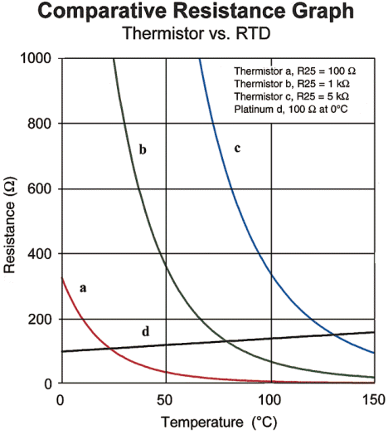

Slide 30
LM 34
· Calibrated directly in degrees Fahrenheit
· Linear +10.0 mV/°F scale factor
· 1.0°F accuracy guaranteed (at +77°F)
· Rated for full -50° to +300°F range
· Suitable for remote applications
· Low cost due to wafer-level trimming
· Operates from 5 to 30 volts
· Less than 90 µA current drain
· Low self-heating, 0.18°F in still air
· Nonlinearity only ±0.5°F typical
· Low-impedance output, 0.4Ohm for 1 mA load

Slide 31
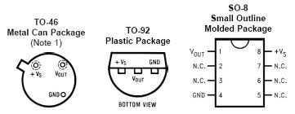

Slide 32
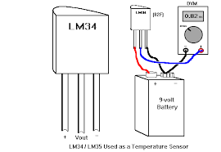

Slide 33
LM35
· Directly calibrated in °Kelvin
· 1°C initial accuracy available
· Operates from 400 μA to 5 mA
· Less than 1Ω dynamic impedance
· Easily calibrated
· Wide operating temperature range
· 200°C overrange
· Low cost
10mV/K

Slide 34
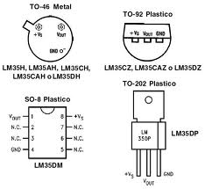

Slide 35
Thermocouple
In 1821, the German–Estonian physicist Thomas Johann Seebeck discovered that when any conductor is subjected to a thermal gradient, it will generate a voltage. This is now known as the thermoelectric effect or Seebeck effect.

Slide 36
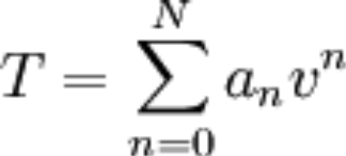
T/C..
A thermocouple is a device consisting of two different conductors (usually metal alloys) that produce a voltage proportional to a temperature difference between the pair of conductors
Thermocouples are self powered and require no external form of excitation

Slide 37
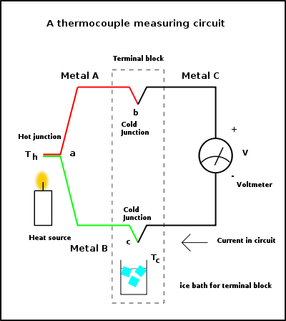

Slide 38
T/C Characteristics
Any junction of dissimilar metals will produce an electric potential related to temperature
Different alloys are used for different temperature ranges
The response is not linear
Extension wire can be done by other metal alloys

Slide 39
Types
Type K (chromel{90 percent nickel and 10 percent chromium}–alumel)(Alumel consisting of 95% nickel, 2% manganese, 2% aluminium and 1% silicon) is the most common general purpose thermocouple , −200 °C to +1350 °C
Type E (chromel–constantan) , non magnetic

Slide 40
Type J (iron–constantan)
Type N (Nicrosil–Nisil) (Nickel-Chromium-Silicon/Nickel-Silicon), 1200 °C
Type B thermocouples use a platinum–rhodium. One conductor contains 30% rhodium while the other conductor contains 6% rhodium 1800 °C

Slide 41
Type R thermocouples use a platinum–rhodium alloy containing 13% rhodium for one conductor and pure platinum for the other conductor. Type R thermocouples are used up to 1600 °C.
Type S thermocouples are constructed using one wire of 90% Platinum and 10% Rhodium (the positive or "+" wire) and a second wire of 100% platinum (the negative or "-" wire). Like type R, type S thermocouples are used up to 1600 °C

Slide 42
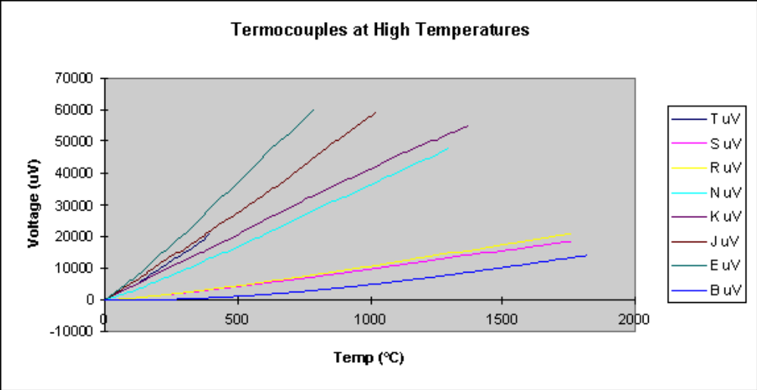

Slide 43
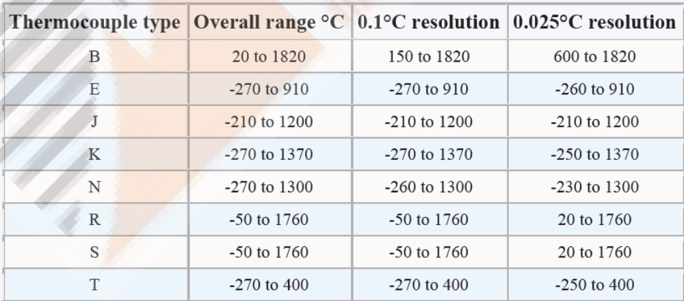

Slide 44


T/C laws
Law of homogeneous material
Law of intermediate materials
Law of successive or intermediate temperatures

Slide 45
T/C Advantages
No need of electrical power for biasing
Inexpensive
Wide temperature range

Slide 46
T/C Disadvantages
Less Accuracy
Need reference junction
Not for low span temperature
Different types for different ranges

Slide 47
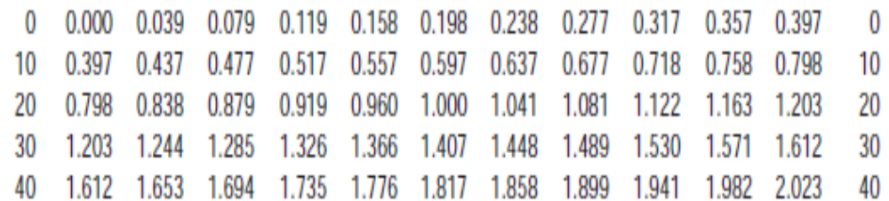
In the table, left most column and right most colum are temp in °C and remain are change in voltage in mV for each °C for K type

Slide 48
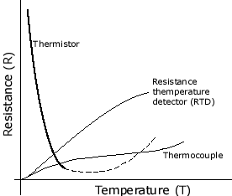
Characteristics of Temp Sensors

Slide 49
Pyrometer
A pyrometer is a non-contacting device that intercepts and measures thermal radiation, a process known as pyrometry. This device can be used to determine the temperature of an object's surface.
There are two principles used for the construction of radiation temperature measuring devices, a) Total radiation pyrometer and b) Selective pyrometer. Under selective type, there are two more and they are optical, infrared

Slide 50
Radiation Pyrometer
In total radiation, the output signal of the detector (Temperature T) is related to the thermal radiation or irradiance j* of the target object through the Stefan–Boltzmann law, the constant of proportionality σ, called the Stefan-Boltzmann constant and the emissivity ε of the object.

Slide 51
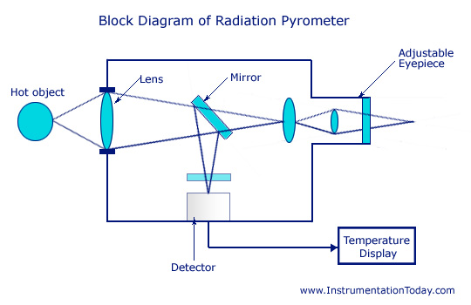

Slide 52
Radiation Pyrometer..
The detector may either be a thermistor or photomultiplier tubes.
Though the latter is known for faster detection of fast moving objects, the former may be used for small scale applications.
Thus, the heat energy is converted to its corresponding electrical signal by the detector and is sent to the output temperature display device.

Slide 53
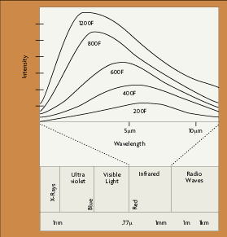
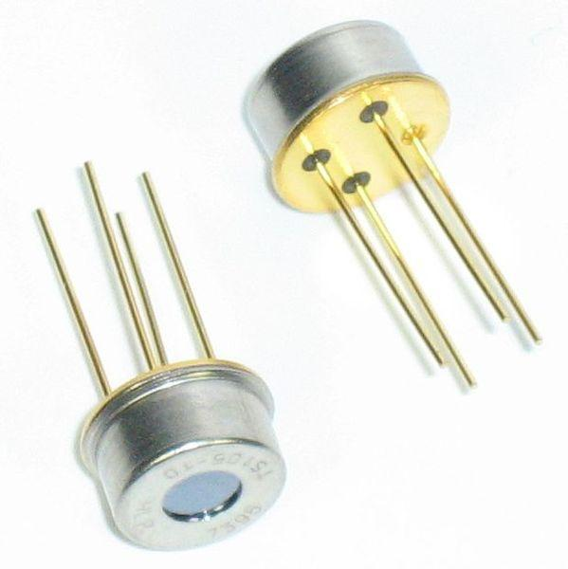
IR Pyrometer

Slide 54
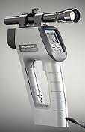
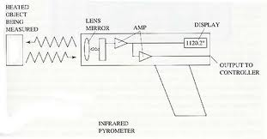
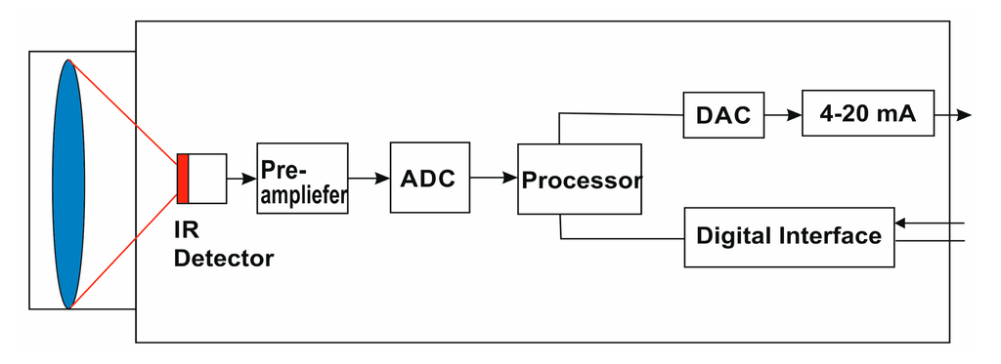
IR Pyrometer

Slide 55
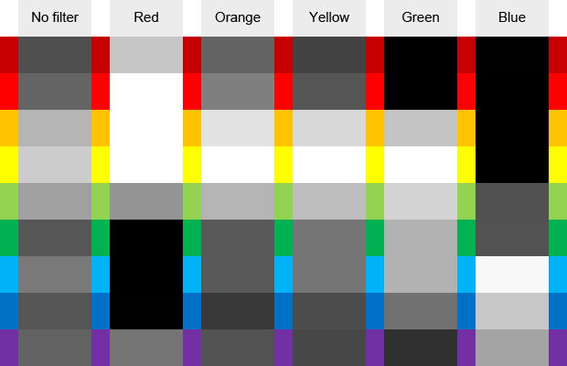
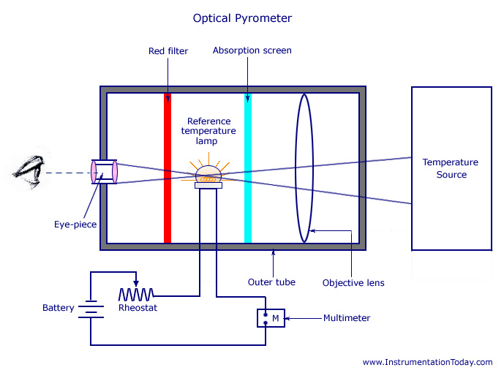
Optical Pyrometer

Slide 56
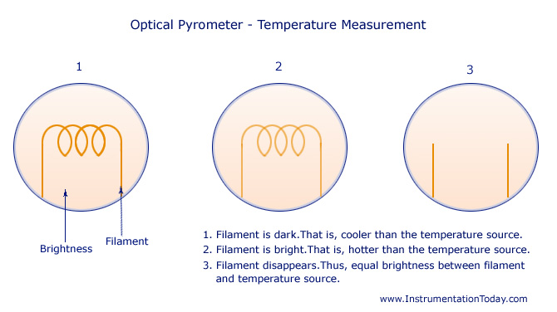

Slide 57
Temperature Transmitters
sensor
Signal Conditioner/manipulator
High impedance A mp
Analog
Controller
Analog Display
Transmitter
lines
Amp
ADC
Digital Controller
Display

Slide 58
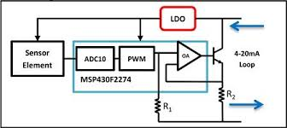
TT..

Slide 59
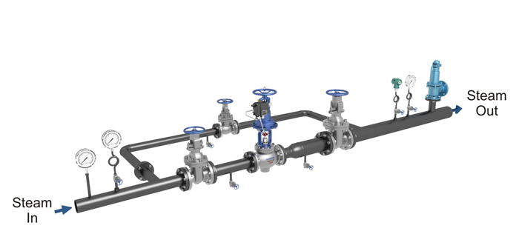
TT..

Slide 60
Transmission may be analog or digital
Analog are 0-20 mA, 4-20mA (live zero), 0-10V, FM, AM
Digital are FSK, ASK, PSK

Slide 61
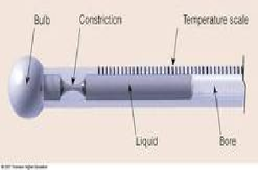
Liquid in Glass Thermometers
Volumetric expansion
A relatively large bulb at the lower end,
A capillary tube with scale,
A liquid filling both the bulb and a portion of the capillary

Slide 62
Alcohol -80 to 70 ºC
Pentane -200 to 30 ºC
Toluene - 80 to 100 ºC
Mercury - 35 to 510 ºC
The empty volume enclosed in the stem above the liquid may be vaccum or be filled with nitrogen gas with pressure to increase the range

Slide 63
Thermometers are commonly made in two types:
a) Total Immersion
b) Partial immersion.
Partial immersion is inherently less accurate then fully immersion types

Slide 64
Characteristics
Simplicity of use and relatively low cost
Easily portable and electrical power is not required
Lack of adaptability to remote reading
Having time lag characteristic

Slide 65
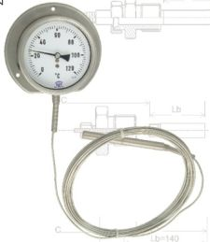
Thermometers using Gas & Vapour
The word vapor in its natural state is a solid or liquid at room temperature.
However, a gas in its natural state at room temperature would still be a gas.

Slide 66
Gas filled system
charle’s law
Pv = RT
Where,
P = absolute pressure.
v = specific volume of the gas.
R = gas constant.
T = absolute temperature.

Slide 67
Nitrogen and helium gases are used as filled gases
range – 240 ºC to 850 ºC

Slide 68
Vapour filled system
The ordinarily used fluids are methyl alcohol, sulphur di-oxide, ether, toluene, butane, propane, and hexane.
P = log e(a-b/t)
Where,
A,b = constant.
P = vapour pressure.
T = temperature.

